Slide 1
AN APPROACH FOR WORKERS SAFETY MONITORING IN INDUSTRIAL CHEMICAL STORAGE TANKS MAINTENANCE USING IOT
Project Members
C.NANDA KUMAR [513417106026]
S.VIKRAM [513417106048]
A.AVINASH [513417106003]
R.ELAN SURIYA [513417106013]
Guided by
Dr.M.MALLESWARAN,
Head of Department, Electronics and Communication Engineering(UG)

Slide 2
PRESENTATION OUTLINE
OBJECTIVE
INTRODUCTION
BLOCK DIAGRAM
CIRCUIT DIAGRAM
FLOW CHART
HARDWARE IMPLEMENTATION
SOFTWARE IMPLEMENTATION
RESULT AND DISCUSSION
CONCLUSION
REFERENCE

Slide 3
OBJECTIVE
This project helps to provide continuous monitoring of workers safety during maintenance of chemical holding tanks.
Observer can analyze the workers health conditions with different gas ppm values indicating whether it is safe for the workers to clean in that environment or not.
Various types of sensors were utilized to monitor parameters from workers like gas sensor, temperature sensor ,pulse rate sensor, etc.
When the sensed value is higher than the threshold value ,system alerts the workers with an alarm signal.
In this proposed system,sensor values have been recorded ,and analyzed on Adafruit.io cloud platformfrom remote location.

Slide 4
INTRODUCTION:
Storage tanks of a variety of shapes and sizes and can be found in all sorts of industries.
They may hold diesel fuel for a company vehicles, purified water for food processing, plastic pellet for injection molding,petroleum power plants or chemicals used to clean or to treat products and equipment.
Although storage tanks are common and their design fairly simple , they can quickly become complicated when it’s time to perform maintenance on them.
Perfuming work inside or on storage tanks can expose workers to flammable, explosive , and toxic chemicals.

Slide 5
The interiors of tanks are usually considered to be confined places, with all challenges and complexities that creates .
But safety in and around tanks is a serious business, especially given the number of fatalities that have resulted.
Some of the major accidents was occurred due to Workers carelessness,Hot works(Welding,cutting,grinding), Unknown chemical reactions between the chemical ,storage tanks,Unplanned maintenance,Work pressure.
It is tough to capture the fluctuation in toxic gas concentration if manually checked.So a wireless contiuous monitoring is required for the workers who works in and around this toxic environment

Slide 6
WORKERS SAFETY MONITORING SYSTEM
Adafruit cloud server
Gas sensor
NodeMCU-12E
multiplexer
Mobile device
Temperature sensor
Pulse sensor
amped
Buzzer

Slide 7
Various sensors like gas sensor (MQ135),pulse sensor, LM35 temperature are used.
The output(analog signal) from this sensors are fed into multiplexer .The multiplexer multiplexes the multiple sensors values into single analog output .
It is then fed into the of the NodeMCU.
The microcontroller performs various process on the incoming multiplexed value and stores the sensors values wirelessly in the adafruit io cloud platform which then can plotted /visualized from a remote place by an observer(safety officer or supervisor).
A buzzer is provided as output to act as alarm

Slide 8
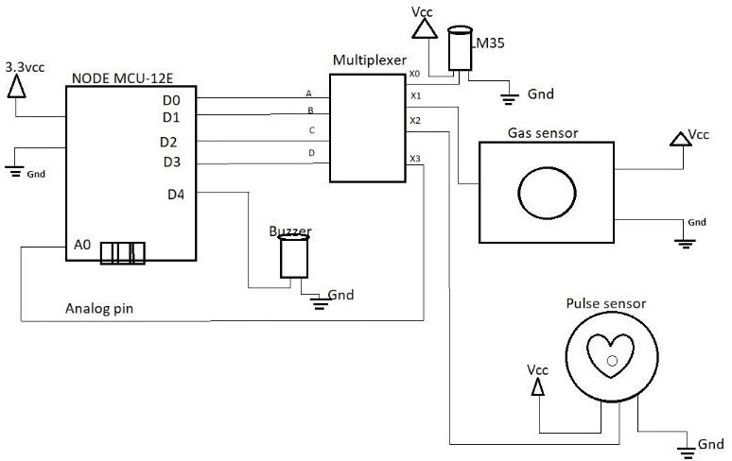
CIRCUIT DIAGRAM:
Figure represents the circuit diagram of the worker safety monitoring module

Slide 9
NodeMCU and sensors are powered with 3.7v battery source .All ground pins are commonly grounded together for error free output.
D0,D1,D2,D3 (GPIO) pins of nodemcu is connected to multiplexer’s A,B,C,D select pins.
Connect buzzer to D4 pin of NodeMCU. X(common input/output) pin1 of multiplexer is connected to analog pin A0 of the multiplexer.
The signal pin from lm35 is connected to pin 9 of multiplexer.The signal pin from pulse sensor amped is connected to pin 8 of multiplexer.
The analog signal from MQ135 gas sensor is connected to pin 7 of multiplexer.pin 15 of multiplexer is grounded through 10K ohm resistor

Slide 10
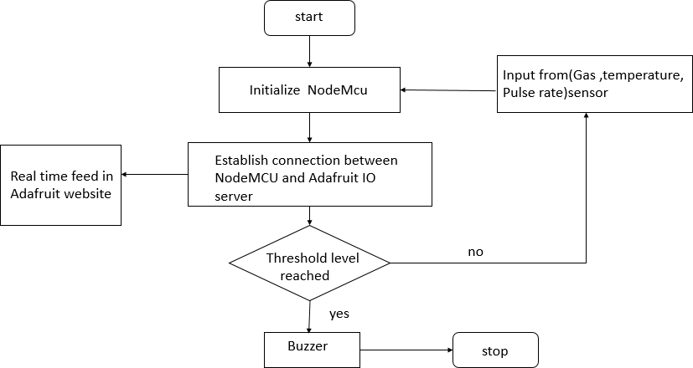
FLOW CHART:
Figure represents flow chart that shows the system design for real time monitoring

Slide 11
The operation begins by initializing the microcontroller.
The microcontroller process the sensor output into desirable parameters such as gas,temperature and pulse.
When wireless connection established between nodemcu and cloud server ,it then stores the data in the cloud as feed data and can be analyzed from remote place.
These sensor parameters are also checked with the threshold values ,when it breaches,system alerts with a buzzer signal.
Normally this prototype is placed in worker body and provides portability.

Slide 12
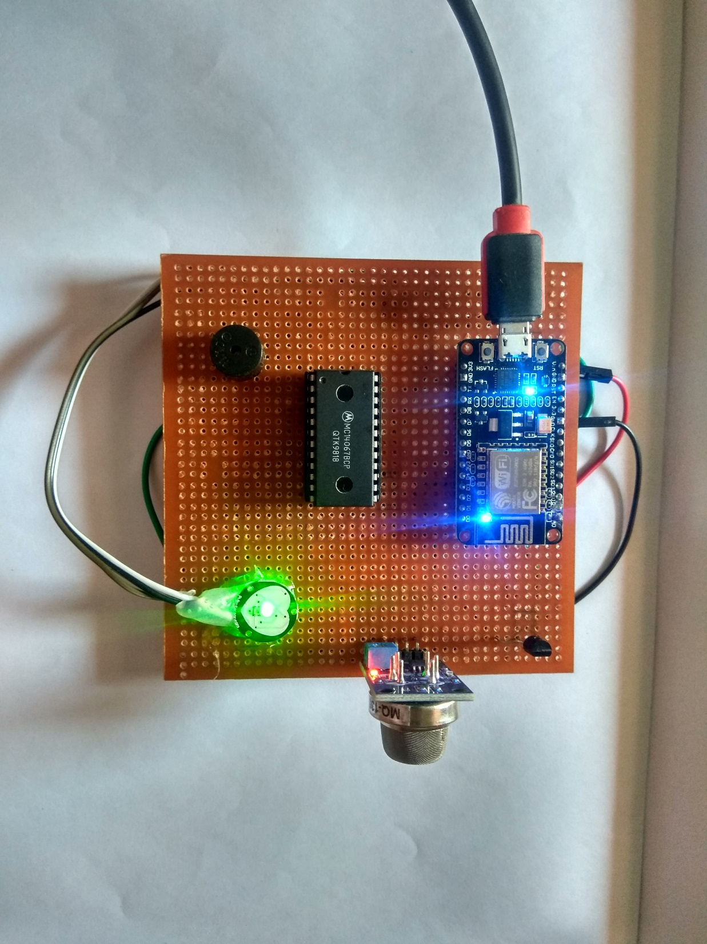
HARDWARE IMPLEMENTATION:
Figure represents Vero board connection of multiple sensors with NodeMCU and a buzzer for alarm

Slide 13
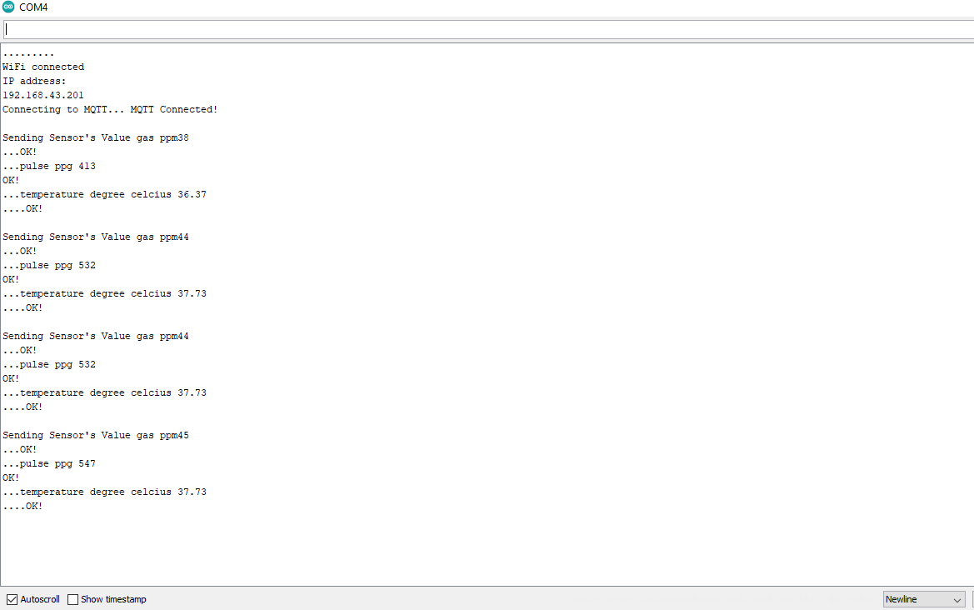
SOFTWARE IMPLEMENTATION:
Figure represents sensor values are successfully uploading into the Adafruit cloud server

Slide 14
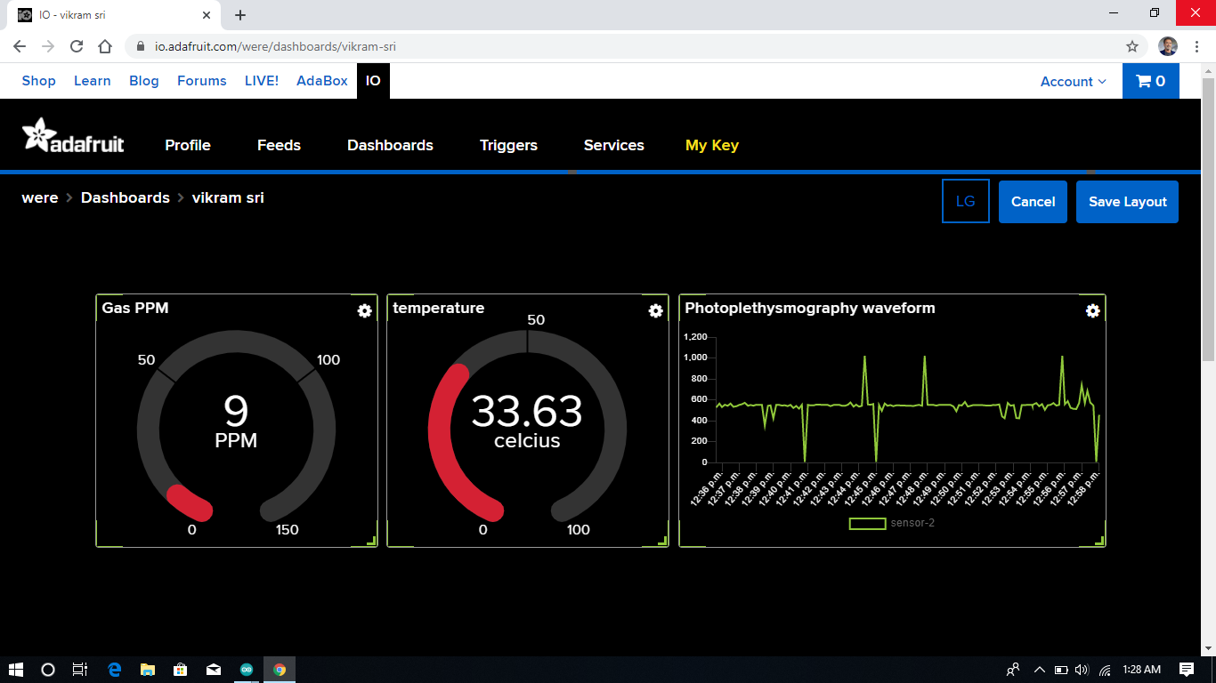
RESULT AND DISCUSSION
Figure represents live data of various sensor values displayed in the adafruit website that can be visualized from remote place

Slide 15
RESULT EXPLANATION:
This result shows the live data of the normal environmental condition.The
sensor data will vary when it is used in the toxic environment
Gas Sensor
- Air quality level in parts per million
0 to 50 ppm(Good),
51-100 ppm(Moderate)
100-150 ppm(Unhealthy to insensitive groups)
Temperature sensor - body temperature in degree celcius
Room temperature- 37 to 45 degree celcius
Pulse sensor – photoplethymosgraphy signal of human body
X-axis-time period
Y axis – pulse sensor data

Slide 16
CONCLUSION:
This device is designed keeping in mind , the measurement of necessary parameters,which needs to be monitored for unhindered safety of the workers in and around the chemical storage tanks .
Apart from industrial safety ,this device finds major application in industries as well manholes.,gutters,deep well, sewage,etc.
This IOT project can be further enhanced with the help of machine learning. This sensor data can be used for training a model and it can tested. Better safety may be achieved with machine learning.

Slide 17
REFERENCES
R.Rajalakshmi,J.Vidhya.”ToxicEnvironment Monitoring Using Sensors Based onArduino”.proceeding International Conference on Systems Computation Automation and Networking.(2019).IEEE 978-1- 7281-1524-5.
PushpakumarR,RajivS.”IOT based smart drainage worker safety system”.2019 International journal of Innovative Technology and Exploring Engineering.ISSN-2278-3075,volume-8 Issue-8 (June).
3) Sudhanshukumar,saketkumar,P.M.Tiwari,RajkumarViral.”Smartsafety monitoring system for sewage workers with two way communication”.2019 6thInternational Conference on Signal Processing and Integrated Networks(SPIN) .
4) Nitin Asthana,RidhimaBahl(2019).”IOT device for sewage gas monitoring and alert system”.

Slide 18
THANK YOU

